Slide 1


Study Anxiety Calculator
A C++ Project Overview
SUBMITED TO:
Miss Aiman Fatima
SUBMITED BY:
Anamta Khurram {SP25- BSSE-0033}
Muhammad Ali Jinnah University

Slide 2


Our Core Objectives & Purpose
Overarching Purpose
Project Objectives
Empower students to improve their study habits.
Precisely assess study-related anxiety levels.
Help identify personal anxiety patterns.
Provide personalized, actionable suggestions.
Foster effective and sustainable learning strategies.
Systematically collect user feedback for continuous improvement.

Slide 3
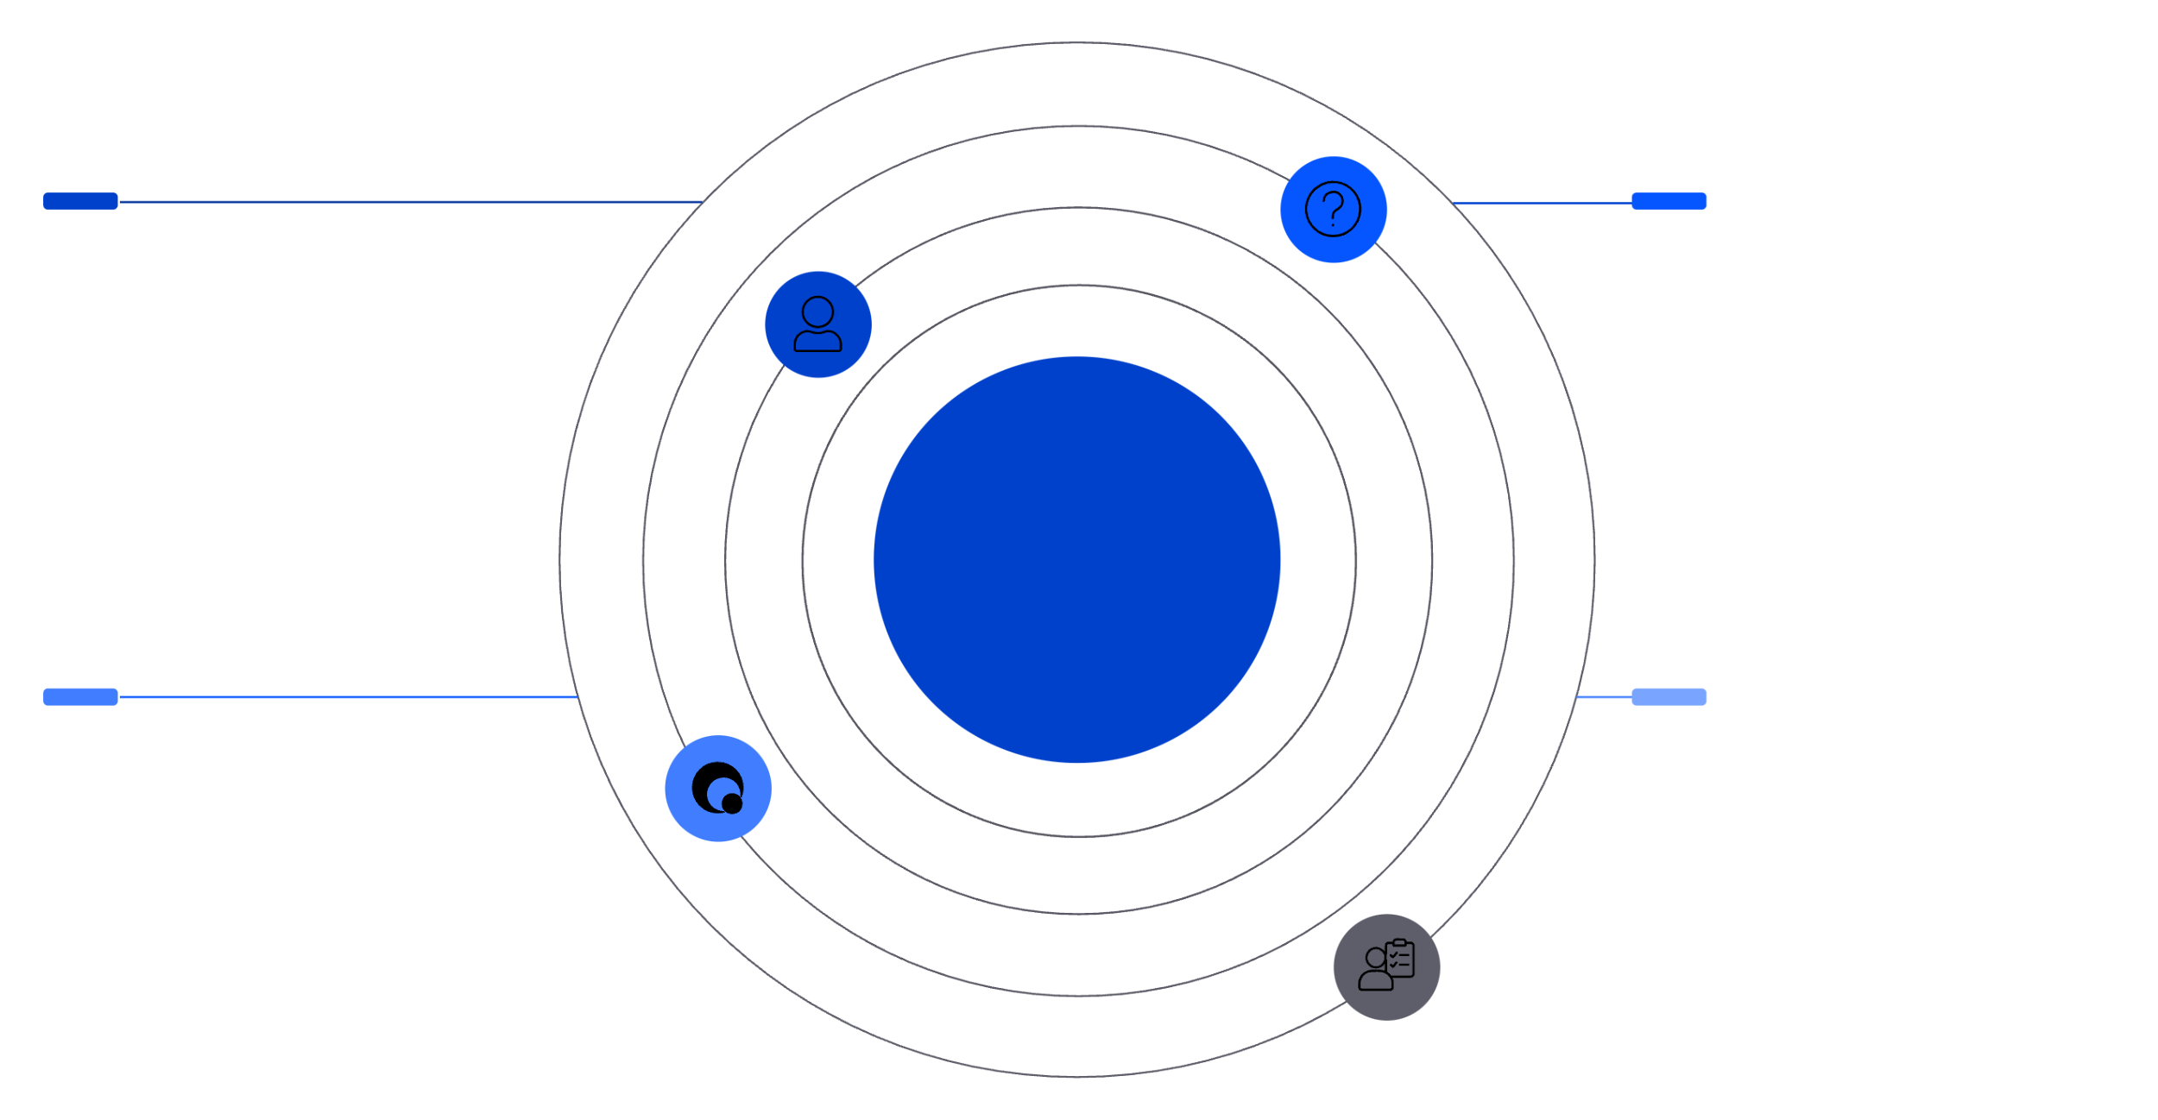




Architectural Blueprint: Class Structure Overview
Our C++ project is built upon a modular, object-oriented design, ensuring scalability and maintainability.
User
Question
SignUp and SignIn methods for authentication
text, options, scores; display and getScore
Class Diagram Overview
Quiz
Assessment & Results
addQuestion, start, getTotalScore, getMaxScore
Assessment (abstract) calculateResult; Result inherits
This structured approach allows for clear separation of concerns and efficient development.

Slide 4


Seamless Experience: User Interaction Flow
The application guides users through a logical sequence, from onboarding to personalised insights.
User Onboarding
Sign Up Sign In
Quiz Engagement
Start Quiz Display Questions Get Choices Calculate Total Score
Result & Analysis
Show Result Display Anxiety Level
Guidance & Feedback
Show Suggestions Collect & Display Feedback

Slide 5
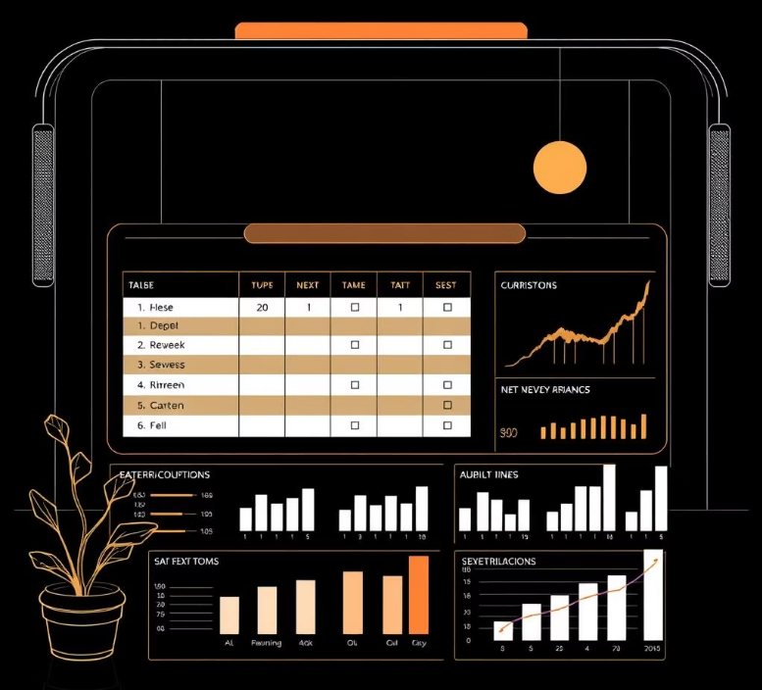
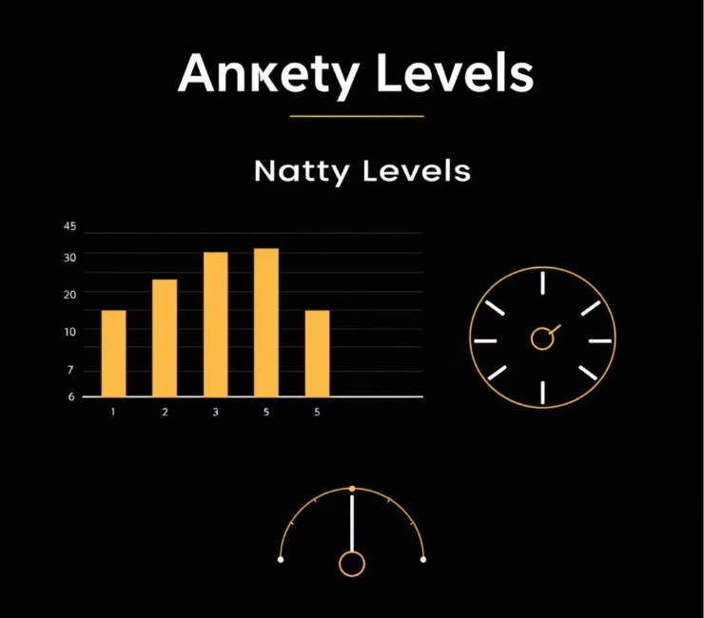
Unveiling Anxiety: Quiz & Scoring Mechanics
Response Scoring Scale
Interpreting Anxiety Levels
Each response contributes to the overall anxiety score.
A clear breakdown of anxiety based on the accumulated score percentage.
Option
Score
Low Anxiety
Never
1
< 40%
Rarely
2
Often
3
Moderate Anxiety
40 – 69%
Always
4
High Anxiety
≥ 70%

Slide 6




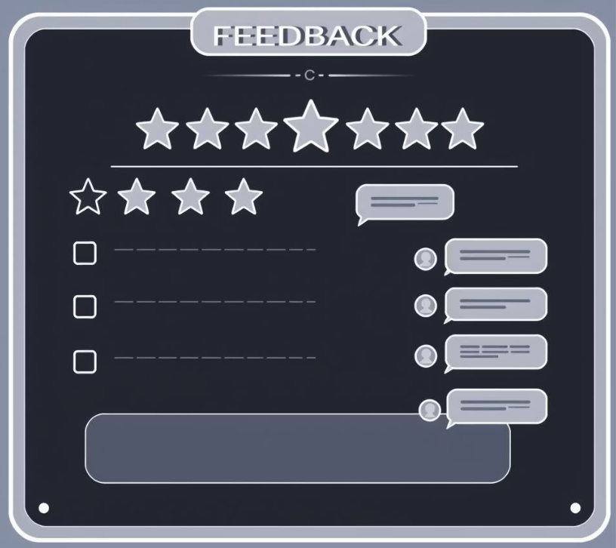

Empowering Action: Suggestions & Feedback
Personalised Study Suggestions
Valuable User Feedback
Tailored advice to mitigate anxiety and foster effective learning.
Crucial for understanding user satisfaction and driving future enhancements.
Satisfaction Rating
High Anxiety
Users provide a rating from 1 to 5 stars, indicating overall experience.
Reduce pressure, ensure proper sleep, explore relaxation techniques.
User Comments
Qualitative feedback is collected, ensuring thoughtful, descriptive input rather than just numerical values.
Moderate Anxiety
Improve time management, integrate regular breaks, avoid last-minute study.
Low Anxiety
Maintain consistent routines, reinforce good study habits.

Slide 7

Key Takeaways: Robust Design, Real-World Impact
Modular OOP Design
Interactive Console-Based
Ensures ease of maintenance, extensibility, and collaboration.
Provides direct, accessible engagement for all users.
Actionable Insights
Empowers students with practical guidance for academic well-being.

Slide 8






Future Horizons: Expanding Potential
Our vision for the Study Anxiety Calculator extends beyond its current capabilities.
Comprehensive Reports
Automated generation of detailed reports for individuals and institutions.
Advanced Analytics
In-depth data visualisations to identify broader trends in student anxiety.
Graphical User Interface (GUI)
Development of an intuitive, visually rich interface for enhanced user experience.

Slide 9

Why This Matters: Supporting Student Well-being
Addressing study anxiety isn't just about academic performance; it's about fostering a healthier, more balanced learning environment for every student. Our tool provides a critical step towards this goal.
By providing a means to understand and manage anxiety, we contribute to a more positive educational journey.

Slide 10

Thank You
Questions & Discussion
We appreciate your time and interest in our project. We are now open for any questions you may have.

